Slide 1


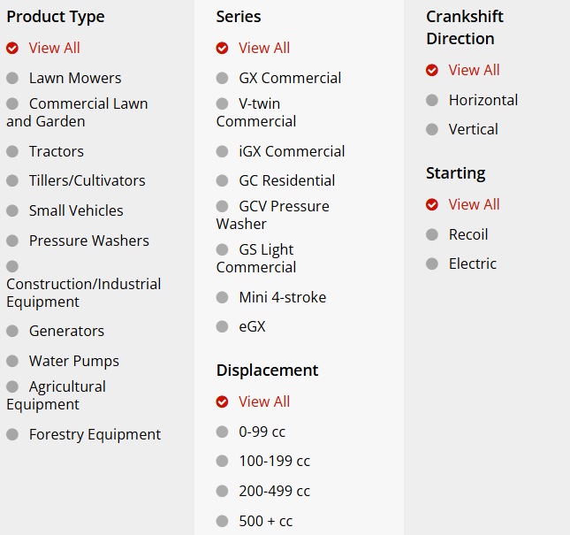

Honda Attribute Comparison
-Bhuman Wadekar
This project leverages machine learning to intelligently recommend the most suitable engine options in a fast, efficient, and data-driven manner, enhancing decision-making for users based on their specific requirements.
This presentation compares Honda engines examining their specifications, performance metrics, and key attributes.
-IT Vedant ,Pimpri PS312
The Image gives the idea of different types of Basic Criteria, Honda uses to classify their engines

Slide 2
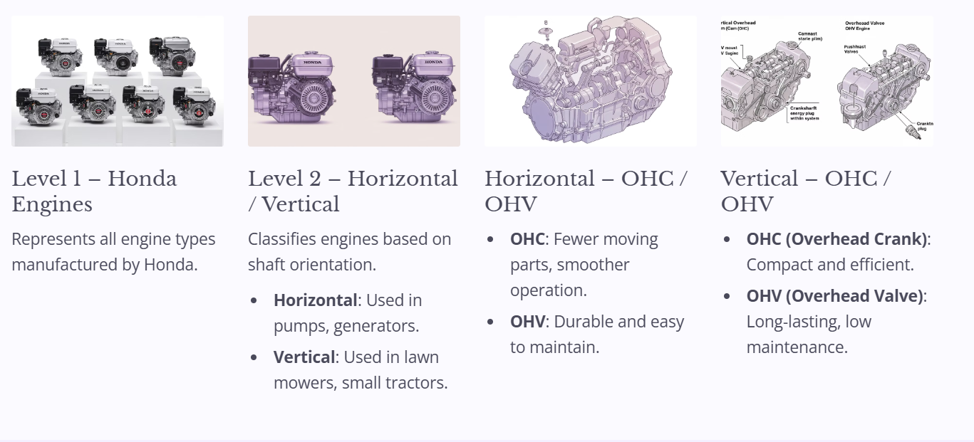

Slide 3
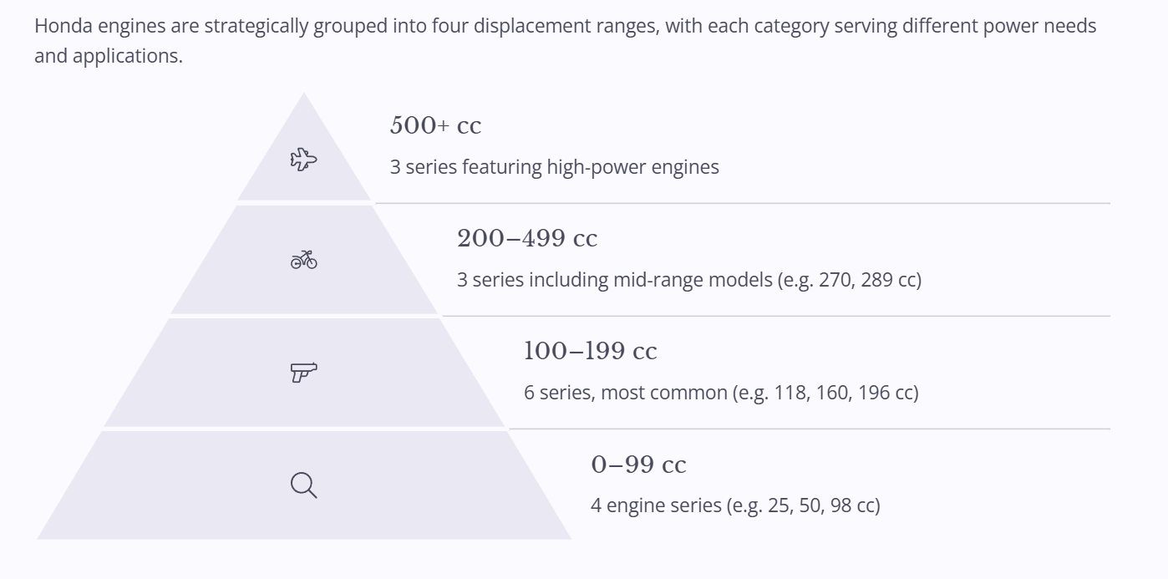
Honda Engines by Displacement (cc)
Honda Engines (Engine Displacement cc)
Engine Disp. (cc) | No of Engine Series
0-99 | 4
100-199 | 6
200-499 | 3
500+ | 3
Previously, we had to visit the site, scrape the entire dataset, manually compare specifications, and decide the appropriate category for each engine—an exhausting and time-consuming process.

Slide 4

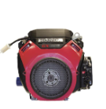
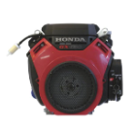
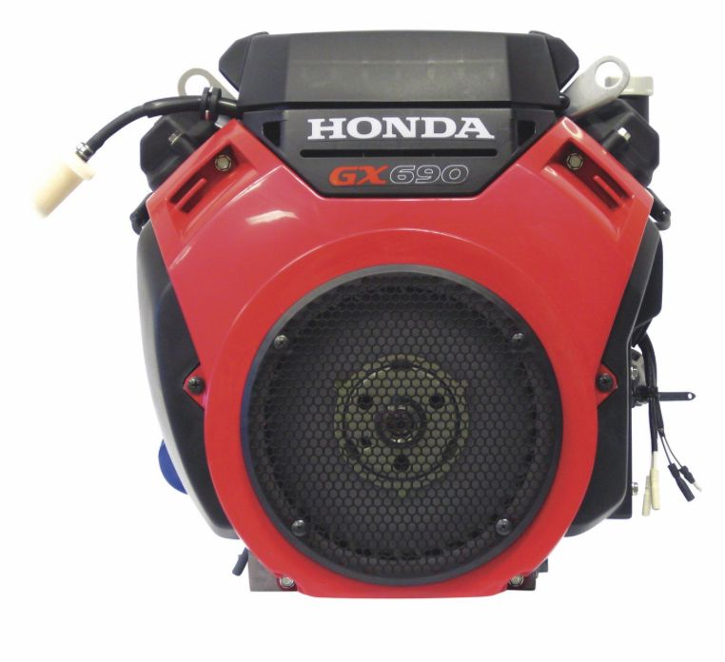
Attribute comparison
Attribute | Criticality | Honda | Honda | Honda | Honda | Honda
 |  | GX690RHTDW | GX690RHXTXA2 | GX630RHQYF | GX630RHVXE1 | GX630RHQZB2
Engine Displacement | Primary | 688 cc | 688 cc | 688 cc | 688 cc | 688 cc
Maximum Power | Primary | 22.1 hp | 22.1 hp | 20.8 hp | 20.8 HP | 20.8 HP
Engine Type | Primary | GX Series OHV V-twin | GX Series OHV V-twin | GX Series OHV V-twin (Commercial) | GX Series OHV V-twin Commercial-duty | GX Series OHV V-twin Commercial-duty
Start Type | Primary | Electric | Electric | Electric | Electric | Electric
Charging System | Primary | 17 Amp | 17 Amp | 17 Amp | 2.7 Amp | 17 Amp
Bore x Stroke | Primary | 3.1 x 2.8 in | 3.1 x 2.8 in | 3.1 x 2.8 in | 3.1 x 2.8 in | 3.1 x 2.8 in
Oil Capacity | Primary | 2.1 qt | 2.0 qt | 2.0 qt | 2 qt | 2 qt
Valve Type | Primary | OHV | OHV | OHV | OHV | OHV
Brand |  | Honda | Honda | Honda | Honda | Honda
Muffler Included |  | No | No | No | No | No
Air Filter |  | Dual Element | Dual Element | Dual Element | Dual Element | Dual Element
Carburetor |  | Int. vents | Int. vents | Int. vents | 2-barrel, Fuel Cut Solenoid, Inner Vent | 2-barrel, Fuel Cut Solenoid, Inner Vent
Cylinders (qty.) |  | 2 | 2 | 2 | 2 | 2
Dry Weight |  | Not Specified | Not Specified | Not Specified | Not Specified | Not Specified
Shaft Diameter |  | 1-1/8 in | 1-1/8 in | 1 in | Tapered | 1 in
Shaft Keyway |  | 0.25 in | 0.25 in | 0.25 in | - | 0.25 in
Shaft Rotation |  | Horizontal PTO / Counter Clockwise | Horizontal PTO / Counter Clockwise | Horizontal PTO / Counter Clockwise | Counter Clockwise | Counter Clockwise
Fuel Type |  | Gasoline | Gasoline | Gasoline | Gasoline | Gasoline
Air Cooling System |  | Air | Air | Air | Air | Air

Slide 5

Streamlining with Machine Learning
Automating engine comparison & category assignment
Quick, accurate recommendations without manual effort

Slide 6
Why Machine Learning Matters
Key Benefits
Results
Analyzes complex patterns across attributes
Faster decisions
Reduces human error
Tailored recommendations
Scales efficiently
Minimal intervention

Slide 7
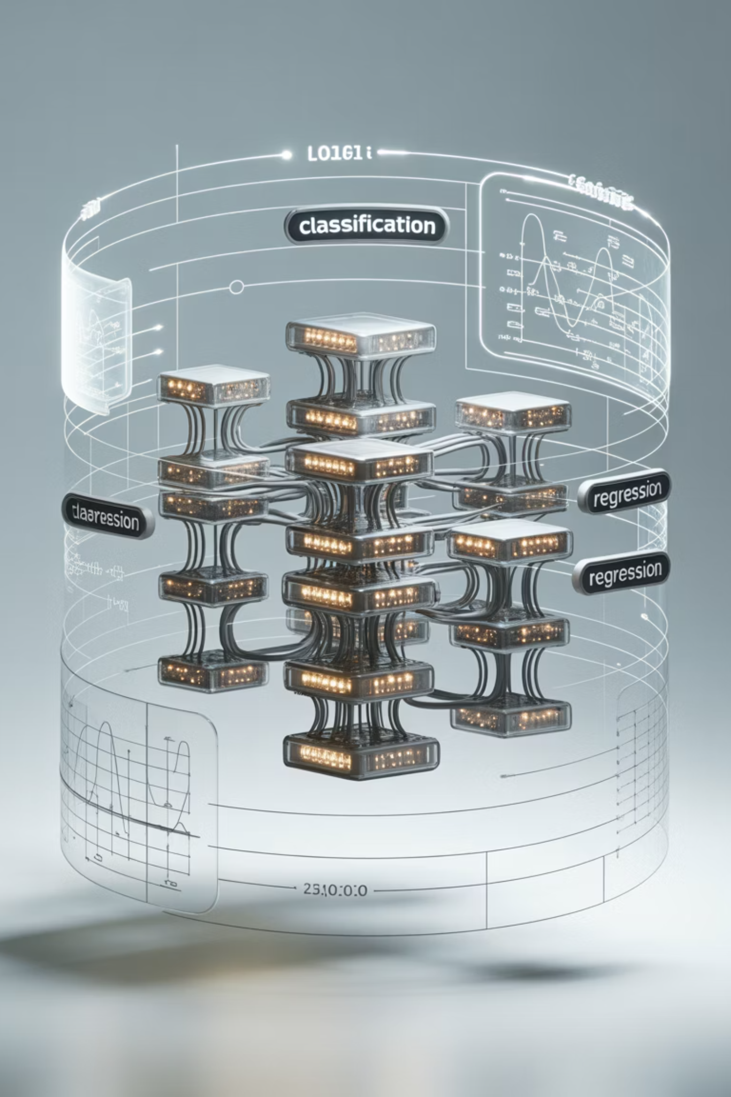



Advanced Multi-Model System
Dual Model Integration
Classification + regression models for comprehensive predictions
Automatic Selection
System chooses highest accuracy models without manual intervention
Efficient Deployment
Best models saved via joblib for consistent, worry-free performance

Slide 8

Final Result
Lets Check It Out

